Slide 1

Chad Green
From Zero to Serverless
DogFoodCon
October 4, 2018

Slide 2


Who is Chad Green
Data & Solutions Architect at ProgressiveHealth
Community Involvement
Code PaLOUsa Conference Chair
Louisville .NET Meetup Organizer
Louisville Tech Leaders Meetup Co-Organizer
Louisville Tech Ladies Committee Member
Contact Information
→ chadgreen@chadgreen.com
 chadgreen.com
 ChadGreen
 ChadwickEGreen

Slide 3
What is Serverless Computing
From Zero to Serverless

Slide 4

The evolution of application platforms
On-Premises
What is the right size of servers for the business needs?
How do I deploy new code to my servers?
What happens in case of server hardware failure?
How can I increase server utilization?
What media should I use to keep backups?
Which packages should be on my server?
Who monitors my App?
How often should I backup my server?
What size of servers should I buy?



Are my servers in a secure location?

How can I scale my app?

What happens if the power goes out?
Do I need a secondary network connection?
Who has physical access to my servers?
Which Operating System should I use?
How many servers do I need?
Who monitors my servers?
Do I need a UPS?
What storage do I need to use?
How often should I patch my servers?
It takes how long to provision a new server?
How can I dynamically configure my app?
Notes:
Get Hardware
Get and install Operating System
Get and install application framework
(No Click) Deploy code to the server
Host all of this somewhere in your datacenter
(No Click) Bunch of questions
Backup for your apps
Physical Security
Scaling Up
Monitoring (hardware and application)
And so on
Really important questions – but not key to core competency

Slide 5
The evolution of application platforms
IaaS
What is the right size of servers for my business needs?
How can I increase server utilization?
How many servers do I need?
How can I scale my application?





How often should I patch my servers?
How do I deploy new code to my server?
How often should I backup my server?
Which Operating System should I use?
Which packages should be on my server?
Who monitors my application?
Notes:
Infrastructure as a Service

Slide 6
The evolution of application platforms
PaaS
What is the right size of servers for my business needs?
How can I increase server utilization?
How many servers do I need?
How can I scale my application?





Notes:
Platform as a Service
A lot of decisions are easily configurable
(Click) But still have to think about how to scale

Slide 7
The evolution of application platforms
Serverless























The platform for next generation applications
Notes:
Only Problem: How to build your app to best solve business problem?

Slide 8
What is Serverless?
Backend as a Service (BaaS)
Functions as a Service (FaaS)
Area #1
Area #2
Applications that significantly or fully depend on services (in the cloud) to manage server-side logic and state
Application run in stateless compute containers that are event-triggered, ephemeral, and fully managed by a 3rd party
Notes:
Like many trends in software there is no one clear view of what ‘Serverless’ is, and that is not helped by it really coming to mean two different but overlapping areas.
Area #1 – Serverless was first used to describe applications that significantly or fully depended on 3rd party applications or services (“in the cloud”) to manage server-side logic and state. These are typically “rich client” applications (think single page web apps or mobile apps) that use the vast ecosystem of cloud accessible databases, authentication services, etc. <CLICK> These type of services are better referred to as Backend as a Service (BaaS)
Area #2 – Serverless can also mean applications where some amount of server-side logic is still written by the application developer but unlike traditional architectures is run in stateless compute containers that are event-triggered, ephemeral (may only last for one invocation), and fully managed by a third party. <CLICK> One way to think of this is Function as a Service (FaaS).

Slide 9
What is Serverless?
Backend as a Service (BaaS)
Functions as a Service (FaaS)
Area #1
Area #2
Applications that significantly or fully depend on services (in the cloud) to manage server-side logic and state
Application run in stateless compute containers that are event-triggered, ephemeral, and fully managed by a 3rd party
Notes:
Like many trends in software there is no one clear view of what ‘Serverless’ is, and that is not helped by it really coming to mean two different but overlapping areas.
Area #1 – Serverless was first used to describe applications that significantly or fully depended on 3rd party applications or services (“in the cloud”) to manage server-side logic and state. These are typically “rich client” applications (think single page web apps or mobile apps) that use the vast ecosystem of cloud accessible databases, authentication services, etc. <CLICK> These type of services are better referred to as Backend as a Service (BaaS)
Area #2 – Serverless can also mean applications where some amount of server-side logic is still written by the application developer but unlike traditional architectures is run in stateless compute containers that are event-triggered, ephemeral (may only last for one invocation), and fully managed by a third party. <CLICK> One way to think of this is Function as a Service (FaaS).

Slide 10


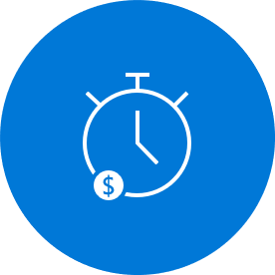
What is Serverless?
Abstraction of Servers
Event-Driven/Instant Scale
Micro-Billing

Slide 11

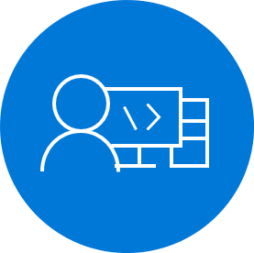
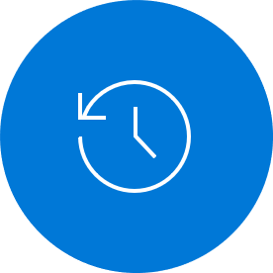
Benefits of Serverless
Manage apps not servers
Reduced DevOps
Faster Time to Market

Slide 12
Serverless Scale
Nano Services
Notes:
Monolith
Microservices
Functions → Nano Services

Slide 13
Challenges of Serverless Architecture
Complexity
Organizational Support
No Runtime Optimization
Notes:
Complexity: Managing a monolithic application as a single unit is more straightforward than managing a fleet of purpose-built functions and the dependencies between them.
Organization Support: It’s a non-trivial consideration for some to move to a serverless paradigm
No Runtime Optimization: By its very nature, you mostly do not have control over the execution environment for the workload.

Slide 14
Serverless Options
From Zero to Serverless

Slide 15
Serverless Options
Zimki
Google Cloud Functions
Amazon Lambda
IBM Cloud Functions
Auth0 WebTask
Azure
Notes:
The first “pay as you go” code execution platform was Zimki, released in 2006, <click>but it was not commercially successful – domain is for sale
Google Cloud Functions : Event-driven serverless compute platform
AWS Lambda : Run code without thinking about servers. Pay only for the compute time you consume.
IBM Cloud Functions: Based on Apache OpenWhisk, IBM Cloud Functions is a polyglot function-as-a-service programming platform for developing lightweight code that scalably executes on demand
Auth0 WebTask: All you need is code

Slide 16


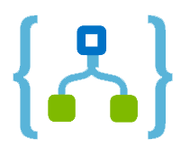
Azure Serverless
Functions
Execute your code based on events you specify
Logic Apps
Design workflows and orchestrate processes
Event Grid
Manage all events that can trigger code or logic
Notes:
Azure Functions is an event-driven compute experience that allows you to execute your code, written in the programming language of your choice, without worrying about servers. Benefit from scale on demand and never pay for idle capacity.
Logic Apps provides serverless workflows that allow developers to easily integrate data with their apps instead of writing complex glue code between disparate systems. Logic Apps also allow you to orchestrate and connect the serverless functions and APIs of your application.
Event Grid is a fully managed event routing service that enables rich application scenarios by connecting serverless logic to event coming from multiple Azure services or from your own apps.

Slide 17
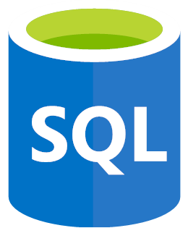


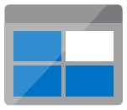




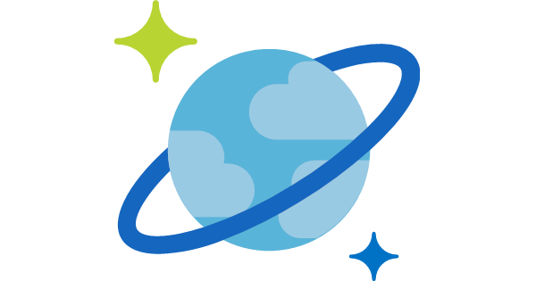
Azure Serverless
Functions
Execute your code based on events you specify
Logic Apps
Design workflows and orchestrate processes
Event Grid
Manage all events that can trigger code or logic
Database
Storage
Security
IoT
Analytics
Intelligence
Notes:
Azure Functions is an event-driven compute experience that allows you to execute your code, written in the programming language of your choice, without worrying about servers. Benefit from scale on demand and never pay for idle capacity.
Logic Apps provides serverless workflows that allow developers to easily integrate data with their apps instead of writing complex glue code between disparate systems. Logic Apps also allow you to orchestrate and connect the serverless functions and APIs of your application.
Event Grid is a fully managed event routing service that enables rich application scenarios by connecting serverless logic to event coming from multiple Azure services or from your own apps.
Backend as a Service
Azure Databases deliver a database ally for your serverless app. Azure SQL, MySQL, and Progress provide industry standard database capabilities. Cosmos DB is a multi-model database service that provides transparent scaling and replication of your data to wherever your users are.
Azure Storage provides durable, highly available, and massively scalable cloud storage to developers for cloud applications. Get options for unstructured object data, structured datasets, file storage, and queue storage for serverless communication between cloud apps.
Azure Active Directory provides cloud-based identity and access management. Using it, developers can securely control access to resources and manage and authenticate the users of their serverless apps.
IoT
Azure Stream Analytics is a fully managed analytics service for real-life streaming data. It allows you to author queries in simple, declarative, SQL-like language, and you only pay for the processing used per job. Event hubs is a fully managed service that simplifies mass ingestion of small data inputs, typically from devices and sensors, to process, route, and store the data.
Azure Bot Service allows you to build intelligent serverless bots that can interact with your users contextually through multiple channels like text/SMS, Skype, Microsoft Teams, Slack, Office 365, Twitter, and other popular services. Cognitive Services allows you to easily add intelligent features such as emotion and sentiment detection, vision, and speech recognition, language understanding, and knowledge and search – into your app. Using these services through serverless code or logic workflows minimizes the learning curve for creating intelligent apps.

Slide 18
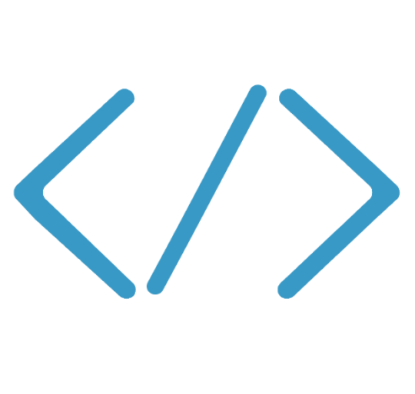


Code
Events + data
Azure Functions
From Zero to Serverless

Slide 19
Azure Functions Architecture
Code
Config
Language Runtime
C#, Node.js, F#, PHP, etc.
WebJobs Script Runtime
Azure Functions Host – Dynamic Compilation, Language abstractions, etc.
WebJobs Core
WebJobs Extensions
Programming model, common abstractions
Triggers, input, and output bindings
App Service Dynamic Runtime
Hosting, CI, Deployment Slots, Remote Debugging, etc.
Notes:
Cake Diagram
Azure Functions are built on top of Azure App Service and WebJobs SDK

Slide 20
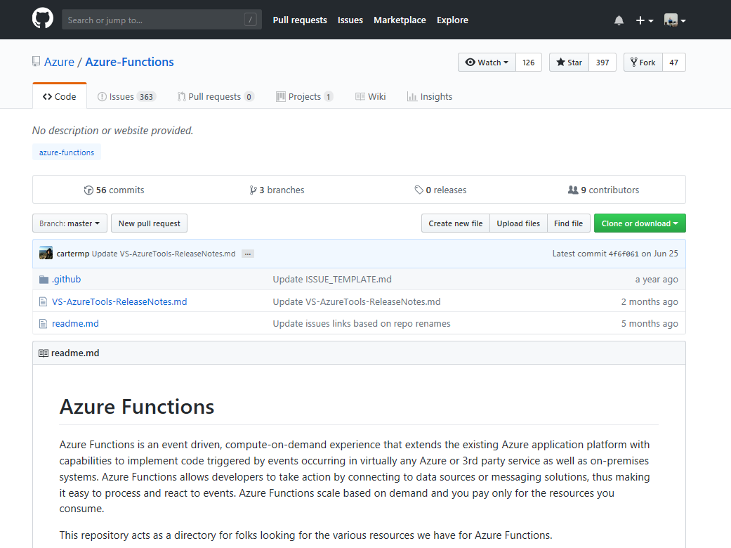








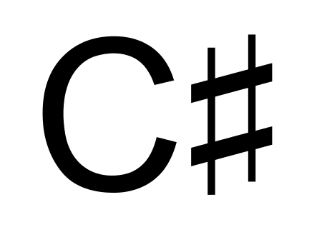








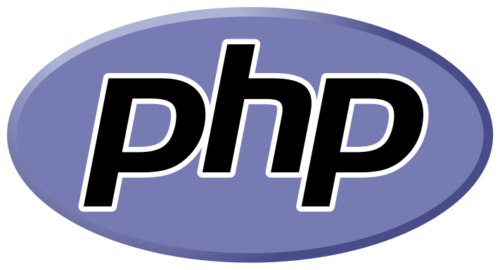



Features of Azure Functions
Choice of language
Pay-per-use pricing model
Bring your own dependencies
Integrated security
Simplified integration
Flexible development
Open-source
Batch
Notes:
Choice of language: Azure Functions is a polyglot solution which allows you to write functions in not just C#, F#, and JavaScript, but also Java, Python, PHP, TypeScript, Batch, Bash, and PowerShell
Choice of language: Azure Functions is a polyglot solution which allows you to write functions in not just C#, F#, and JavaScript, but also Java, Python, PHP, TypeScript, Batch, Bash, and PowerShell
Pay-per-use pricing model: Pay for only the time spent running your code. Azure Functions consumption plan is based on per-second resource consumption and executions.
Bring your own dependencies: Functions support both NuGet and NPM, so you can use your favorite libraries.
Integrated security: Protect HTTP-triggered functions with OAuth providers such as Azure Active Directory, Facebook, Google, Twitter, and Microsoft Account.
Simplified integration: Easily leverage Azure services and software-as-a-service (SaaS) offerings. These services can trigger your function and start execution or they can serve as input and output for your code. Such services include Cosmos DB, Event Hubs, Event Grid, Mobile Apps, Notification Hubs, Service Bus, Azure Storage, GitHub, and Twilio SMS messages
Flexible development: Code your functions right in the portal or set up continuous integration and deploy your code through GitHub, Visual Studio Team Services, and other support development tools including OneDrive, Bitbucket, Dropbox, and either a local or external Git repository
Open-source: The Functions runtime is open-source and available on GitHub

Slide 21
Triggers and Bindings
Type
Service
Trigger
Input
Output
Schedule
Azure Functions

HTTP (REST or webhook)
Azure Functions


Blob Storage
Azure Storage



Events
Azure Event Hubs


Queues
Azure Storage


Queues and topics
Azure Service Bus


Storage tables
Azure Storage


SQL tables
Azure Mobile Apps


NoSQL DB
Azure Cosmos DB


Push Notifications
Azure Notification Hubs

Twilio SMS Text
Twilio

SendGrid Email
SendGrid

Notes:
Key with Azure Functions is that is supports
Triggers to start execution
Bindings to simplify code for input and output of data
SendGrid?

Slide 22


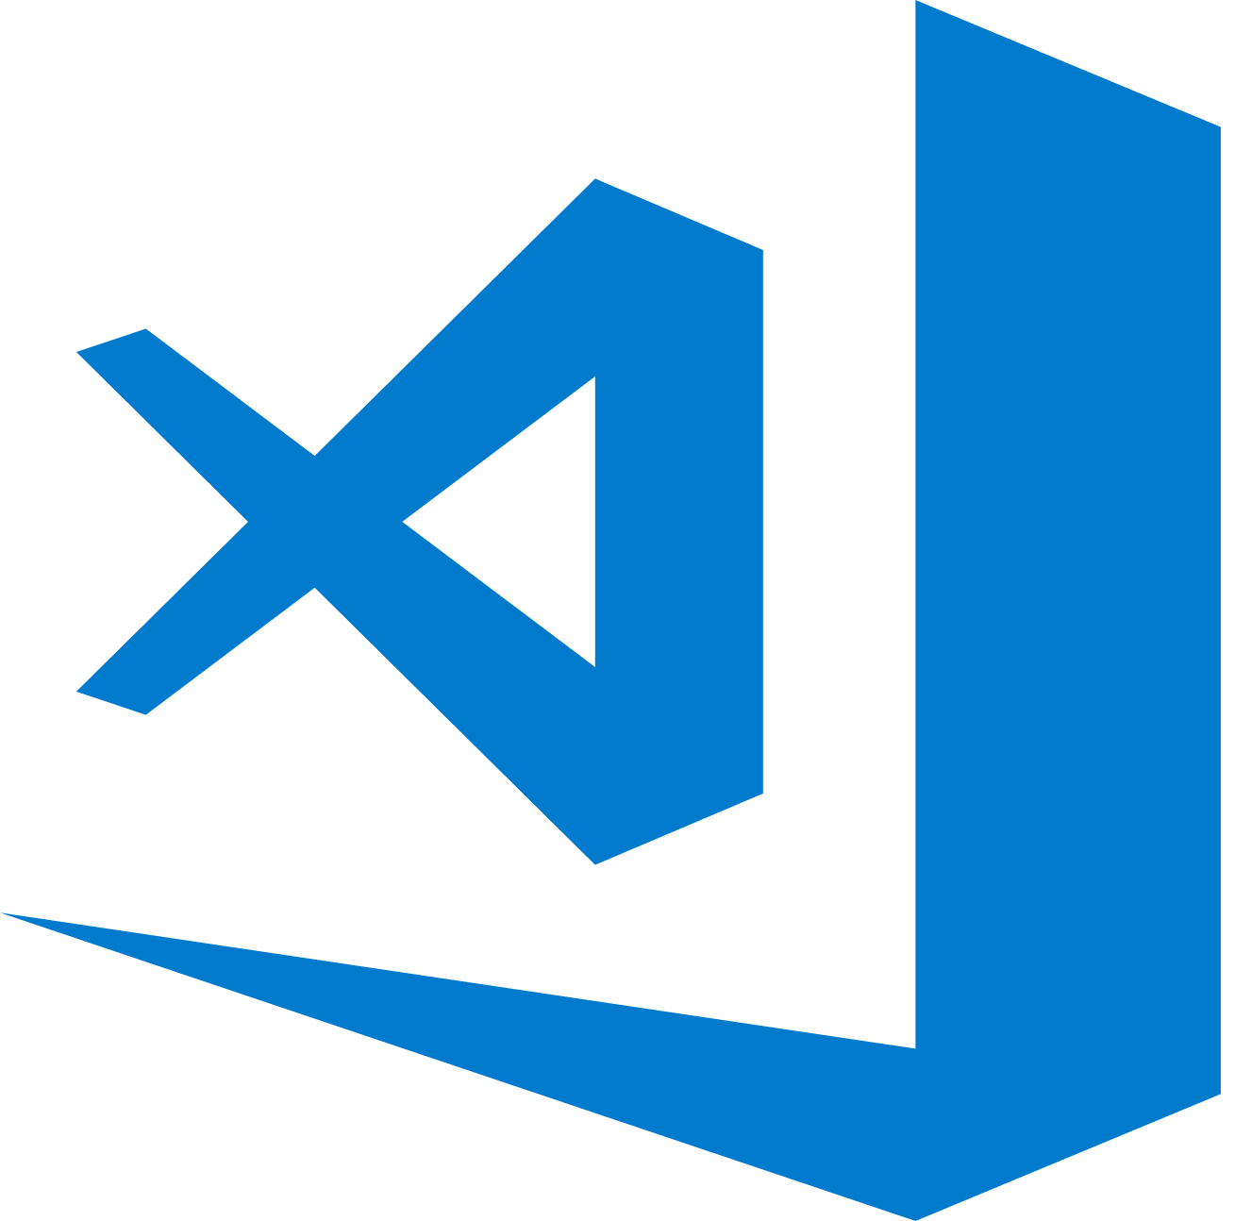
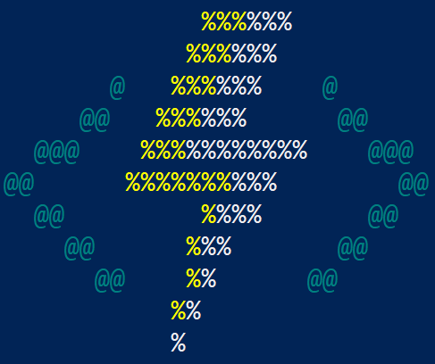
Develop How You Want
Azure Portal
Quickly get started without having to install anything else
Visual Studio 2017
First class C# development experience
Visual Studio Code
First class Node.js development experience
Edit any function project generated via CLI
Azure Functions Core Tools (CLI)
Build any kind of function and edit in IDE of your choice
Notes:
Four different tools you can use to work with Azure Functions
Azure Portal – Quickly get started without having to install anything else
Visual Studio 2017 – First class C# development experience
Visual Studio Code – First Class Node.js development experience plus you can edit any function project generated via the CLI
Azure Functions Core Tools (CLI) – Build any kind of function and edit in IDE of your choice

Slide 23
Runtime Versions
Runtime 1.x
Runtime 2.x
.NET Framework 4.6
Generally Available
.NET Core 2.0
Cross Platform
Language Extensions
Java
Binding Extensions
Microsoft Graph
Durable Functions
Notes:
There are two major versions of the Azure Functions runtime: 1.x and 2.x
Cross-platform development: Runtime 1.x support development and hosting only in the portal or on Windows. Runtime 2.x runs on .NET Core, which means it can run on all platforms supported by .NET Core, including macOS and Linux. This enables cross-platform development and hosting scenarios that are not possible with 1.x.
Languages: Runtime 2.x uses a new language extensibility model. Initially, JavaScript and Java are taking advantage of this new model. Azure Functions 1.x experimental languages have not been updated to use the new model, so they are not supported in 2.x. The experimental languages are Python, PHP, TypeScript, Batch, Bash, and PowerShell.
Runtime 2.x uses a new binding extensibility model that offers several advantages:
Support for third-party binding extensions
Decoupling of runtime and bindings. This allows binding extensions to be versioned and released independently. You can, for example, opt to upgrade to a version of an extension that relies on a new version of an underlying SDK.
A lighter execution environment, where only the bindings in use are known and loaded by the runtime
Microsoft Graph bindings – allow you work with data, insights and events from the Microsoft Graph. Use the Microsoft Graph API to connect to the data that drives productivity – mail, calendar, contacts, documents, directory, devices, and more.
Durable Functions is an extension of Azure Functions and Azure WebJobs that lets you write stateful functions in a serverless environment. The extension manages state, checkpoints, and restarts for you.

Slide 24
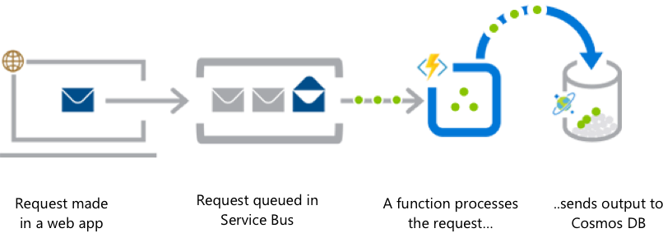
Web Application Backends
Notes:
Online orders are picked up for a queue, processed, and the resulting data is stored in a database

Slide 25
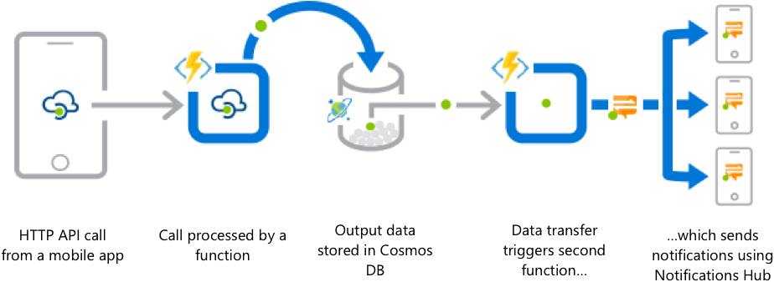
Mobile Application Backends
Notes:
Colleagues use mobile backing to reimburse each other for lunch; the person who paid for lunch requests payment through his mobile app, triggering a notification on his colleagues’ phone.

Slide 26
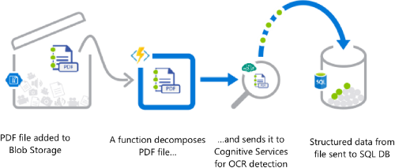
Real-Time File Processing
Notes:
Patient records are securely uploaded as PDF files. That data is then decomposed, processed using OCR detection, and added to a database for easy queries.

Slide 27
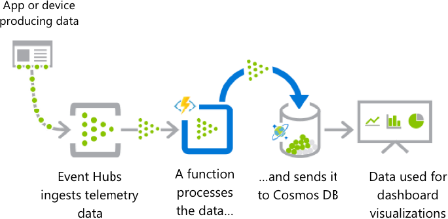
Real-Time Stream Processing
Notes:
Huge amounts of telemetry data is collected from a massive cloud app. That data is processed in near real-time and stored in a DB for use in an analytics dashboard.

Slide 28
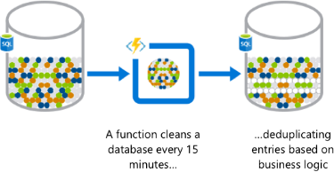
Automation of Scheduled Tasks
Notes:
A customer database is analyzed for duplicate entries every 15 minutes, to avoid multiple communications being sent out to the same customers.

Slide 29
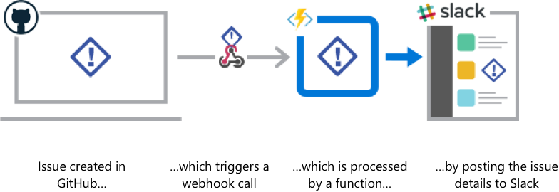
Extending SaaS Applications
Notes:
A SaaS solution provides extensibility through webhooks, which can be implemented through Functions, to automate certain workflows.

Slide 30
Demo 1: Create an Azure Function from the Portal

Slide 31
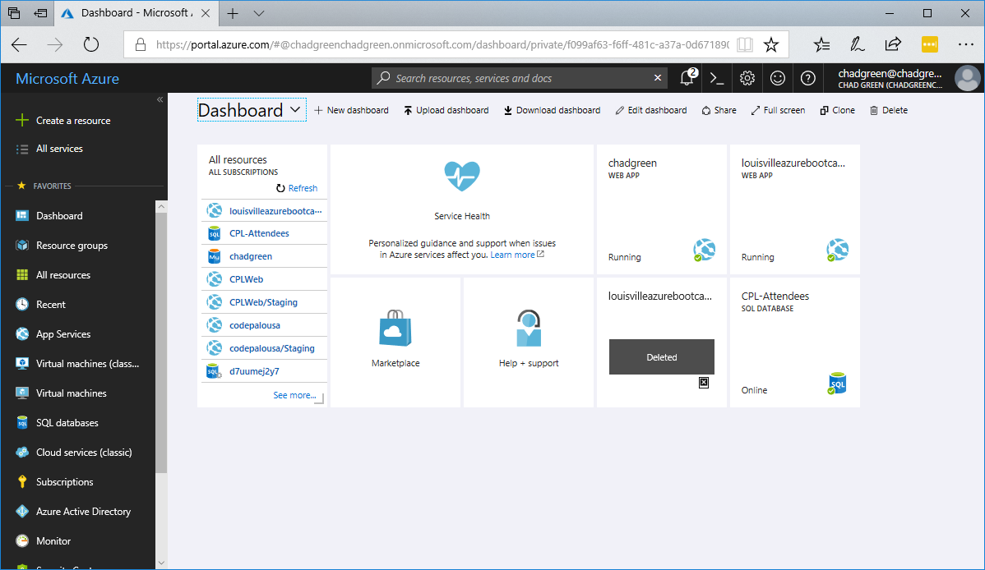
Notes:
Log into the Azure Portal
Sign into the Azure portal at https://portal.azure.com with your Azure account
Click on the Create a resource option

Slide 32
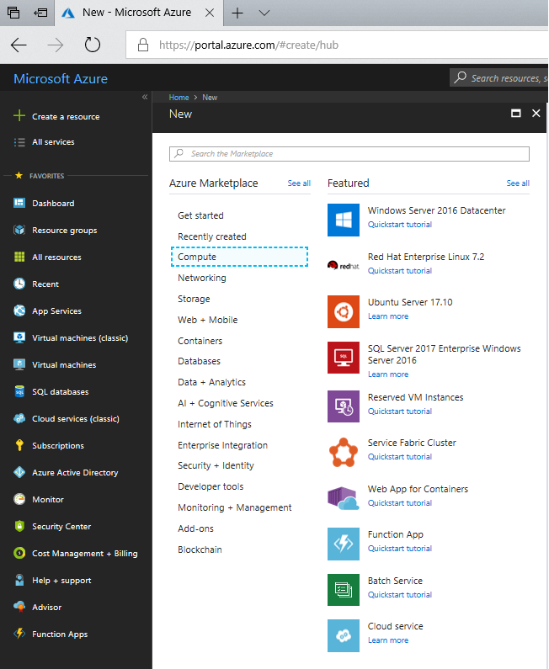
Notes:
Create a function app
You must have a function app to host the execution of your functions. A function app lets you group functions as a logic unit for easier management, deployment, and sharing of resources.
Select the New button found on the upper left-hand corner of the Azure porta, then select Compute > Function App.

Slide 33
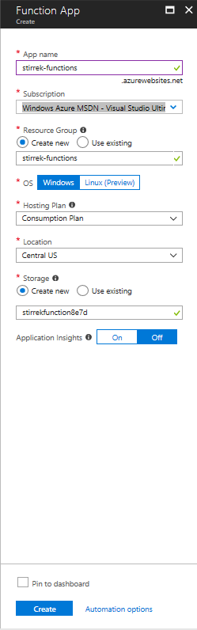
Notes:
Create a function app
Use the function app settings as specified in the table below the image.
App name: Globally unique name that identifies your new function app
Subscription: Your subscription under which this new function app is created
Resource Group: The name for the new resource group in which to create your function app
OS: Severless hosting is currently only available when running on Windows. Linux hosting is in preview and not available with the consumption plan
Hosting Plan: Hosting plan that defines how resources are allocated to your function app. In the default Consumption Plan, resources are added dynamically as required by your functions. In this serverless hosting, you only pay for the time your function run.
Location: Choose a region near you or near other services your function access.
Storage: Name of the new storage account used by your function app. You can also use an existing account.
Select Create to provision and deploy the function app.

Slide 34
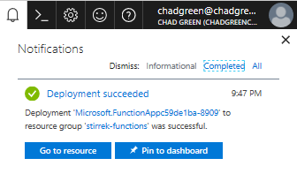
Notes:
Create a function app
Select the Notification icon in the upper-right corner of the portal and watch for the Deployment succeeded message.
Select Go to resource to view your new function app.
Next, we will create a function in the new function app.

Slide 35
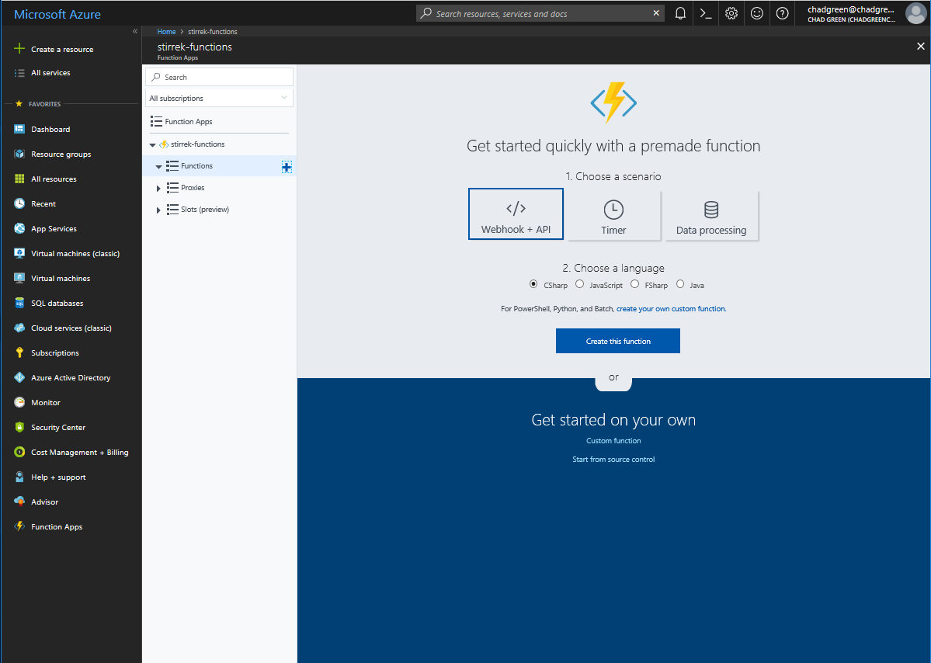
Notes:
Create an HTTP triggered function
Expand your new function app, then click the + button next to Functions.
In the Get started quickly page, select WebHook + API, Choose a language for your function, and click Create this function.
A function is created in your chosen language using the template for an HTTP triggered function.
Now, you can run the function by sending an HTTP request.

Slide 36
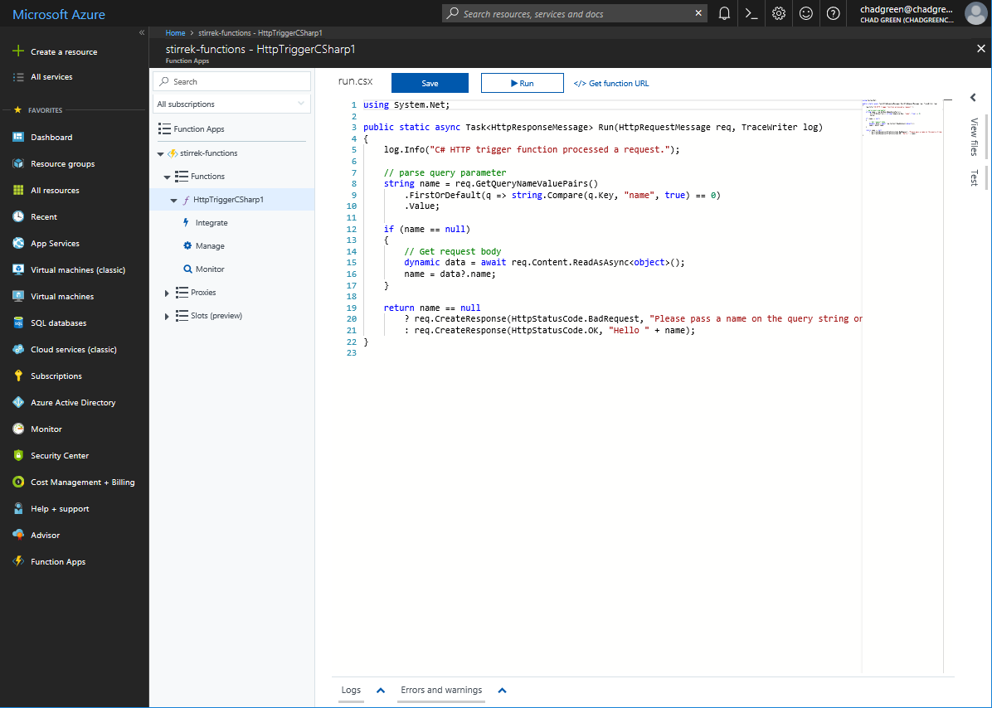
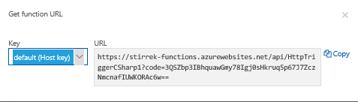
Notes:
Test the function
In you new function, click the </> Get function URL at the top right, select default (Function key), and then click Copy.

Slide 37
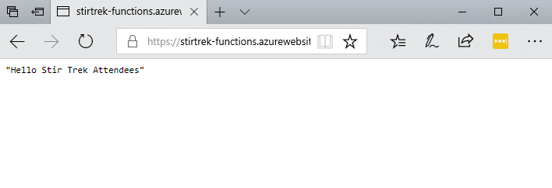
Notes:
Test the function
Paste the function URL into your browser’s address bar. Add the query string value &name=Stir%20Trek%20Attendees to the end of this URL and press the Enter key on your keyboard to execute the request. You should see the response returned by the function displayed in the browser.
The request URL includes a key that is required, by default, to access your function over HTTP.

Slide 38
Demo 2: Create an Azure Function from Visual Studio

Slide 39
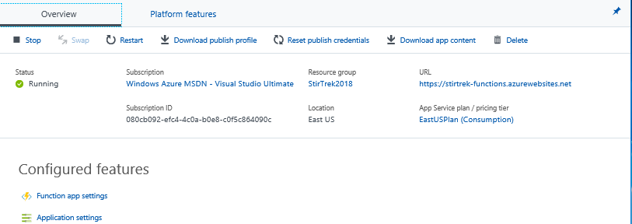
Notes:
Update Runtime Version
Because we are going to use .NET Core for our functions, we will need to update the Runtime version. First thing you will do is go to the Platform features link.

Slide 40
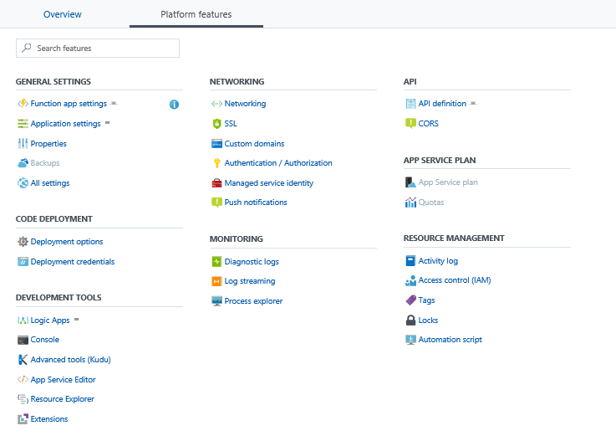
Notes:
Update Runtime Version
From here, we can see all sorts of settings that be managed here to include application settings, deployment options, networking details, monitoring, API definitions, and resource management. But for now, what we care about is the Function app settings option.

Slide 41
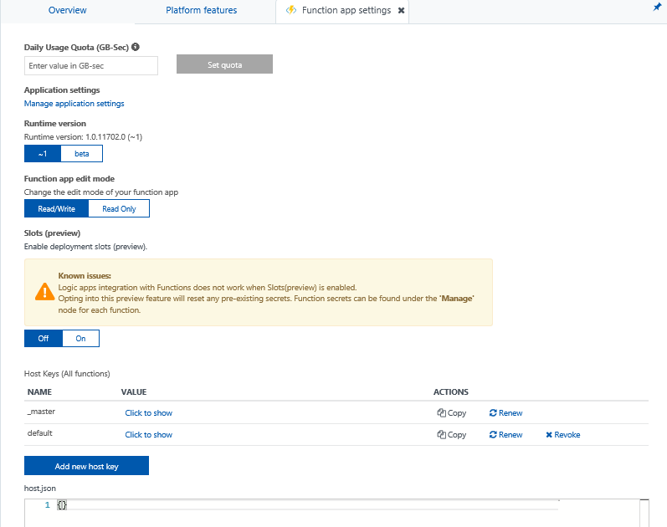
Notes:
Update Runtime Version
From the Function App settings blade, we have control over daily usage quotas, edit modes, the ability to use deployment slots, and update the host keys. The setting we care about right now is the Runtime version, which we will set to beta. After changing that value we see it go from 1.0.11702.0 to 2.0.11651.0.
Also note the Manager application settings, from there we can add the connection string we’ll need for the upcoming demos.

Slide 42
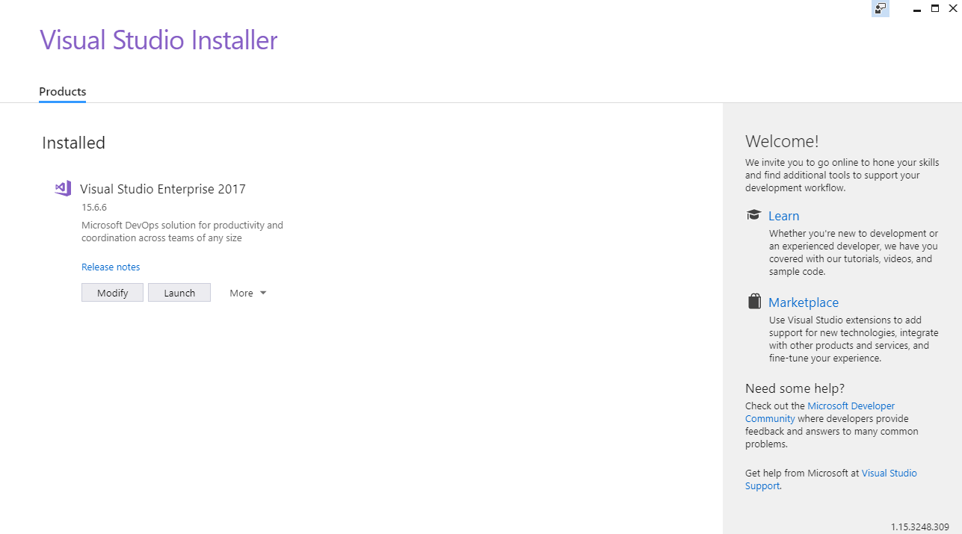
Notes:
Install Visual Studio 2017
Install Visual Studio 2017 version 15.5 or a later version.

Slide 43
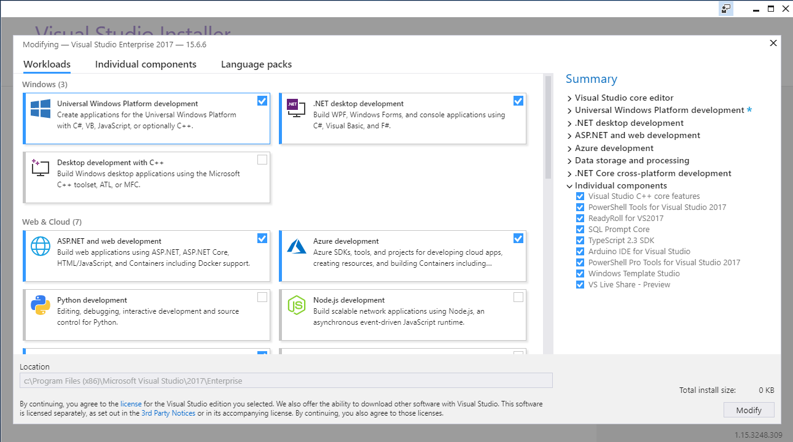
Notes:
Include the Azure development workload
Ensure that you include the Azure development workload

Slide 44
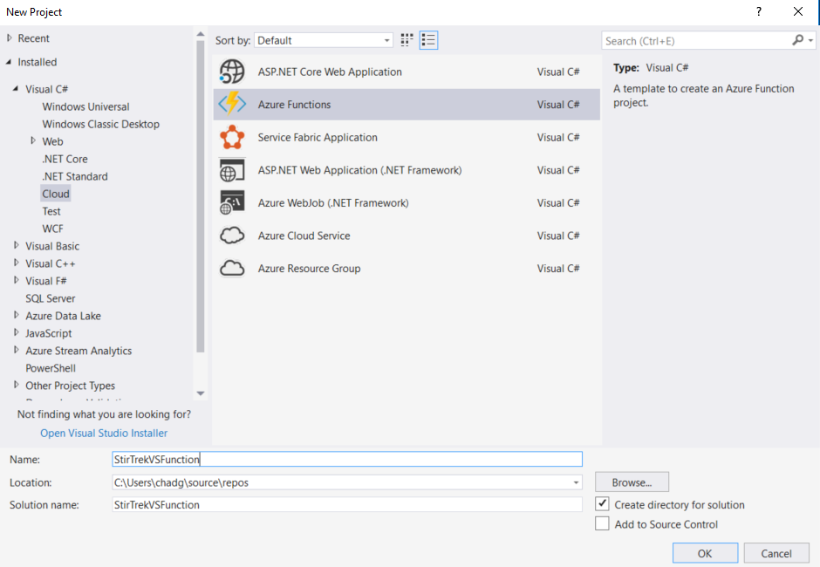
Notes:
Create a function app project
The Azure Functions project template in Visual Studio create a project that can be published to a function app in Azure.
In Visual Studio, select New > Project from the File menu.
In the New Project dialog, Select Visual C# > Cloud, select Azure Functions, type a Name for your project, and click OK. The function app must be valid as a C# namespace, so do not user underscores, hyphens, or any other nonalphanumeric characters.

Slide 45
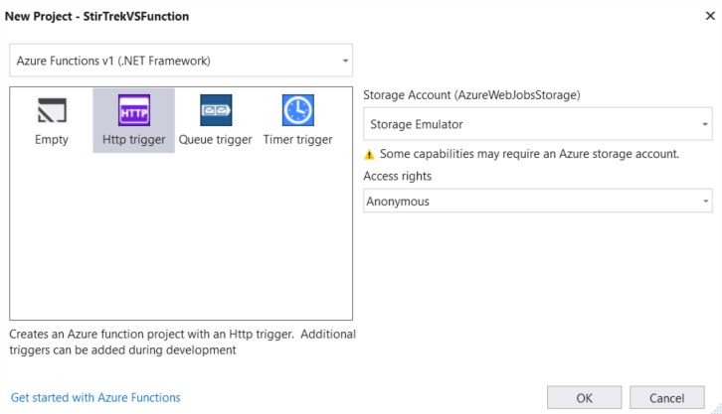
Notes:
Create a function app project
Use the Azure Functions v1 (.NET Framework) for the version. This creates a function that uses the version 1 runtime of Azure Functions. The version 2 runtime, which supports .NET Core, is currently in preview.
Select the HTTP trigger which will create a function triggered by an HTTP request
Select the Storage Emulator storage account option. An HTTP trigger does not use the Storage account connection. All other trigger types require a valid Storage account connection string.
Use the Anonymous access rights. The created function can be triggered by any client without providing a key. This authorization setting makes it easy to test your new function.
Click OK to create the function project and HTTP triggered function.

Slide 46
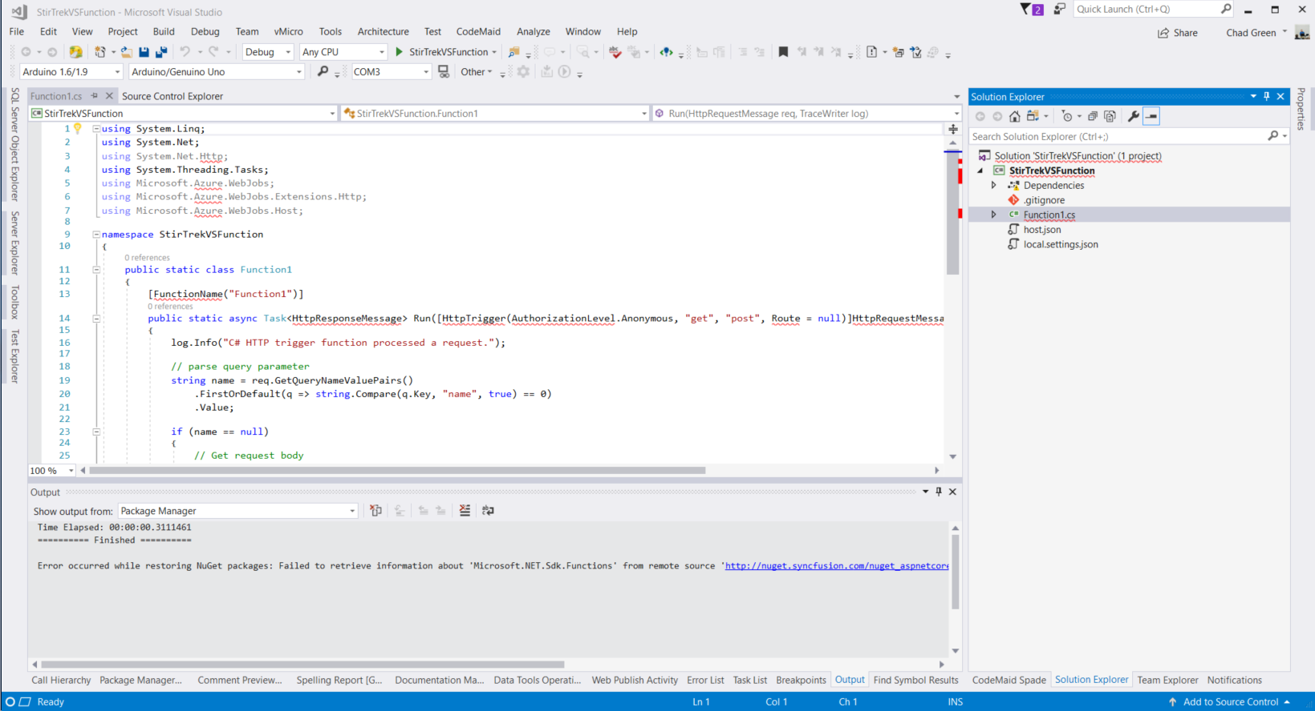
Notes:
Create a function app project
Visual Studio creates a project and in it a class that contains boilerplate code for the chosen function type. The FunctionName attribute on the method sets the name of the function. The HttpTrigger attribute specifies that the function is triggered by an HTTP request. The boilerplate code sends an HTTP response that includes a value from the request body or query string. You can add input and output bindings to a function by applying the appropriate attributes to the method.
Now that we’ve created your function project and an HTTP-triggered function, you can test it on your local computer.

Slide 47
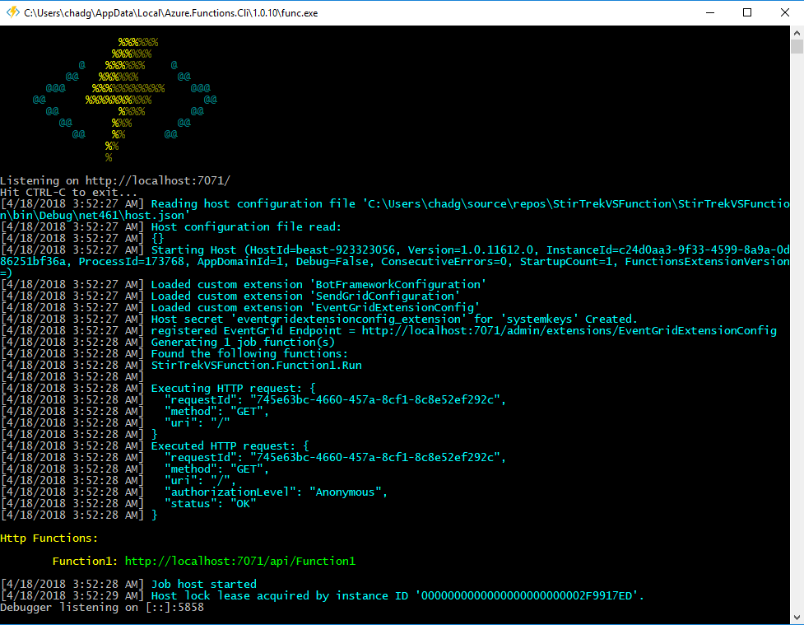
Notes:
Test the function locally
Azure Functions Core Tools lets you run an Azure Functions project on your local development computer.
To test your function press F5. If prompted, accept the request from Visual Studio to download and install Azure Functions Core (CLI) tools. You may also need to enable a firewall exception so that the tools can handle HTTP requests.
Copy the URL of your function from the Azure Functions runtime output.

Slide 48
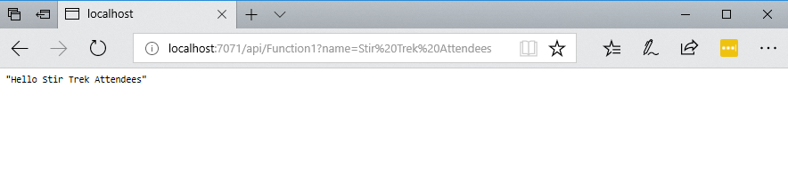
Notes:
Test the function locally
Paste the URL for the HTTP request into your browser’s address bar. Append the query string ?name=<yourname> to this URL and execute the request.

Slide 49
Deployment and Monitoring
Deployment Options
Monitoring Options
Visual Studio
Functions CLI
Visual Studio Team Services
Azure Resource Manager
Maven / Jenkins
Azure App Insights
Function Logs
Azure Monitor (preview)

Slide 50
Demo 3: CI/CD

Slide 51
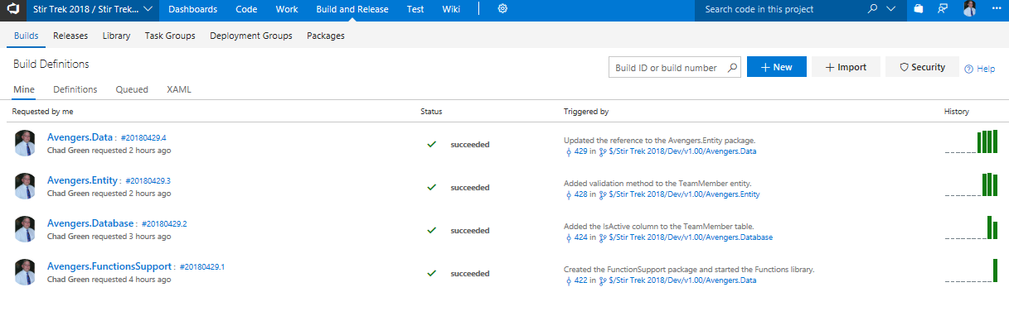
Notes:
Create Build Definition
From the Build and Release menu option, go to Builds, and then click the New build button.

Slide 52
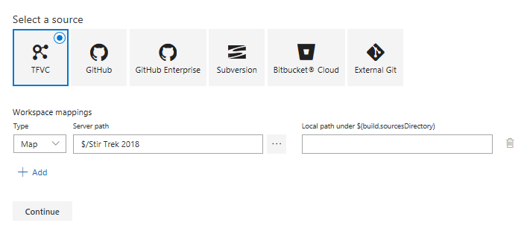
Notes:
Create Build Definition – Select your repository
As with any other build, we first have to specify our repository source and then the workspace mappings. Once done, click the Continue button.

Slide 53
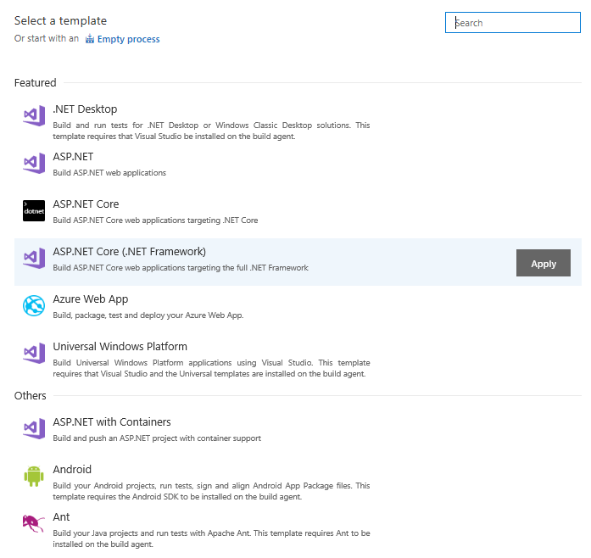
Notes:
Create Build Definitoin – Select your repository
There is no prebuilt template for Azure Functions, but the ASP.NET Core (.NET Framework) has most of the steps that we need the way we need them.

Slide 54
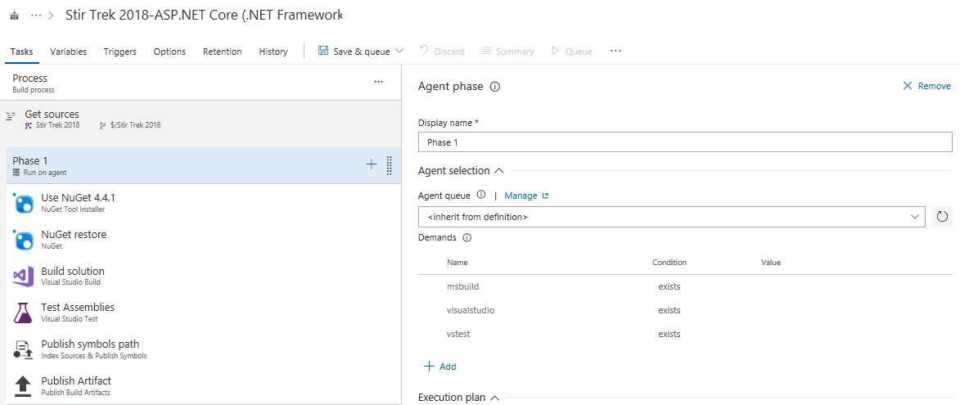
Notes:
Create Build Definition – Task Settings
You can leave all of the options alone.

Slide 55
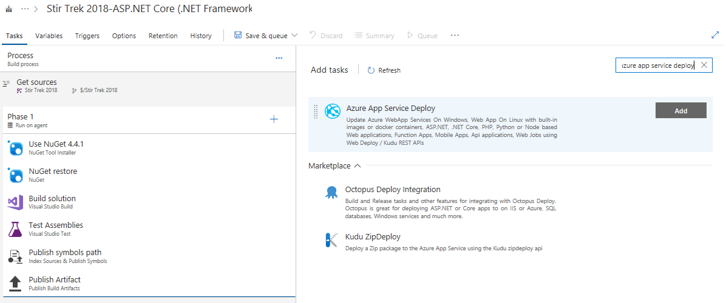
Notes:
Create Build Definition – Add Deployment Task
In order to deploy your functions at the end of the build process, we’ll add the Azure App Service Deploy task. Click on the plus, search for Azure App Service Deploy, and then click the Add button.

Slide 56
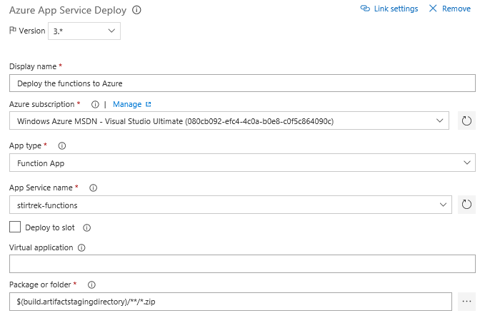
Notes:
Create Build Definition – Add Deployment Task
From here, you will need to specify the following:
The Azure subscription to be associated with the task
The type of application you are deploying to
The name of that App Service
The location of the Package to be deployed

Slide 57
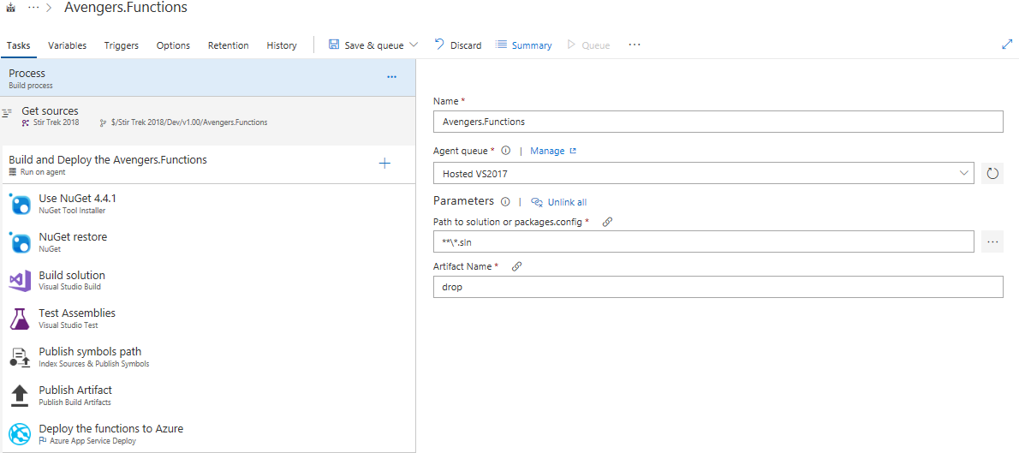
Notes:
Save & Queue Build

Slide 58
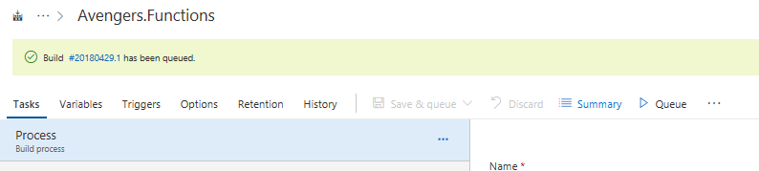
Notes:
Watch Build
Click on the build number to watch the build do its thing.

Slide 59
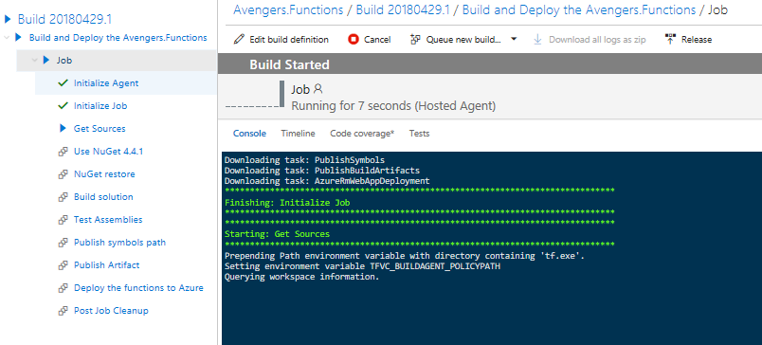
Notes:
Watch Build
Click on the build number to watch the build do its thing.

Slide 60
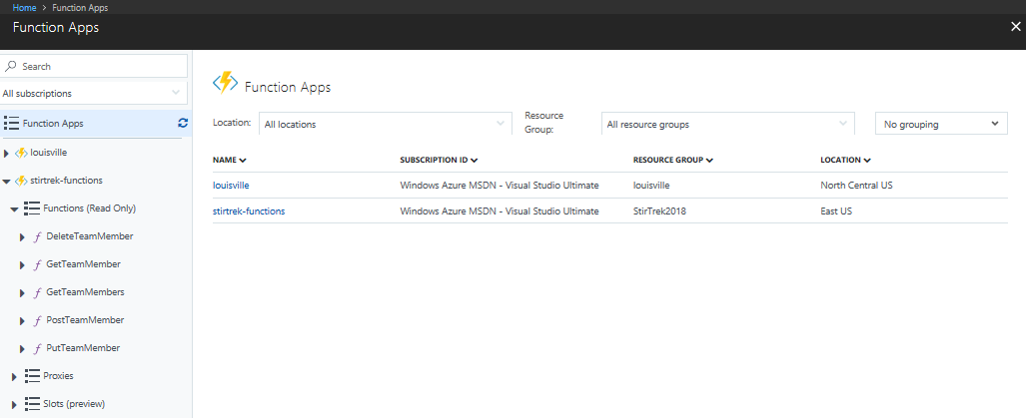
Notes:
Successful Build & Deployment
And now we can see the functions deployed.

Slide 61
Proxies
Provide more control over all functions or just select methods
Can point to any HTTP resource
Take our current function url:
https://stirtrek.azurewebsites.net/api/HttpTriggerCSharp1?code=k9as3MKuDEAOyj3GbniZgJjWrn1cMqTAcDhbzqgAldUcYk67EX8QVg==&name={name}
Our function URL would then be like this:
https://stirtrek.azurewebsites.net/HelloWorld/{name}
Notes:
Azure Functions Proxies allows you to forward requests to other resource. You define an HTTP endpoint just like the HTTP trigger, but instead of writing code to execute when the endpoint is called, you provide a URL to a remote implementation. This allows you to compose multiple API sources into a single API surface which is easy for clients to consume. This is particularly useful if you wish to build your API as microservices (or nanoservices).
A proxy can point to any HTTP resource, such as:
Azure Functions
API apps in Azure App Service
Docker containers in App Service on Linux
Any other hosted API
Routing

Slide 62
Demo 4: Setting up routing and proxies

Slide 63
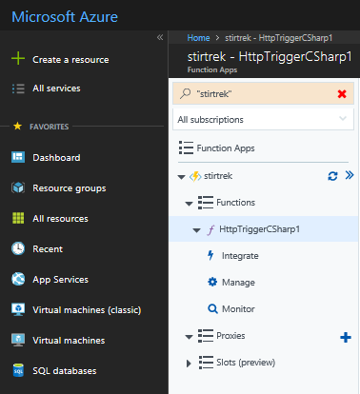
Notes:
Create a HelloWorld Proxy
From the Function App, click on the New proxy plus sign.

Slide 64
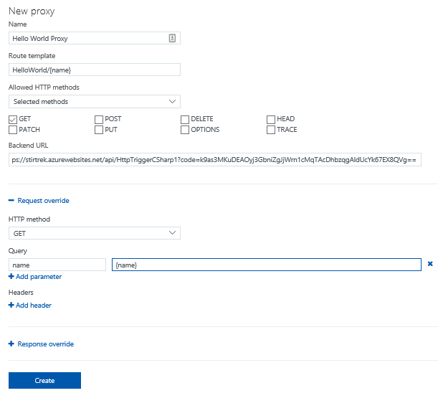
Notes:
Specify the details of the proxy
Enter the name of the for the new proxy
Specify the route template
Optionally – specify which HTTP methods will be allowed to access the proxy
Set the Backend URL to the endpoint of the Azure function
In order to translate the route to a query string, we’ll override the Request
Click the Create button

Slide 65
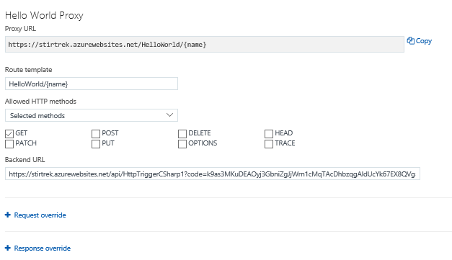
Notes:
Testing the proxy
After the Proxy is created, click on the Copy button to copy the URL to the clipboard

Slide 66

Notes:
Testing the proxy
From Postman:
Paste in the Proxy URL and change the routing variable
Ensure that we are sending a GET
Click on the Send button
Verify the results

Slide 67

Notes:
Making an API out of Azure Functions (Get 1)

Slide 68

Notes:
Making an API out of Azure Functions (Get All)

Slide 69

Notes:
Making an API out of Azure Functions (Create)

Slide 70

Notes:
Making an API out of Azure Functions (Update)

Slide 71

Notes:
Making an API out of Azure Functions (Delete)

Slide 72
Securing your Azure Functions
HTTPTriggers can be protected by OAuth providers
Azure Active Directory
Microsoft Account
Facebook
Google
Twitter
Notes:
Azure Functions Proxies allows you to forward requests to other resource. You define an HTTP endpoint just like the HTTP trigger, but instead of writing code to execute when the endpoint is called, you provide a URL to a remote implementation. This allows you to compose multiple API sources into a single API surface which is easy for clients to consume. This is particularly useful if you wish to build your API as microservices (or nanoservices).
A proxy can point to any HTTP resource, such as:
Azure Functions
API apps in Azure App Service
Docker containers in App Service on Linux
Any other hosted API
Routing

Slide 73
Function Timeouts
Default timeout of 5 minutes
Maximum timeout of 10 minutes
For longer running functions use the App Service Plan and/or Durable Functions
Notes:
Consumption Plan restrictions
The timeout value can be changed by changing the functionTimeout property in host.json
Durable Functions is an extension of Azure Functions and Azure WebJobs that lets you write stateful functions in a serverless environment. The extension manages state, checkpoints, and restarts for you.

Slide 74
Pricing
From Zero to Serverless

Slide 75
Pricing – General Information
No upfront cost
No termination fees
Pay only for what you use

Slide 76
Pricing – Two Different Pricing Plans
Consumption Plan
App Service Plan
Takes care of everything but your code
Pay only when your functions are running
Scale out automatically
You pretty much take care of everything
Consider when:
Existing, underutilized VMs
Function apps to run continuously
More CPU or memory options
Run longer than maximum execution time
Require features only available on App Service plan
Want to run on Linux (on general availability tier)
Notes:
You can run Azure functions in two different modes <click>: Consumption plan and App Service plan. The Consumption plan automatically allocates compute power when you code is running, scales out as necessary to handle power when your code is running, scales out as necessary to handle load, and then scales down when code is not running. You do not have to pay for idle VMs and do not have to reserve capacity in advanced. In the App Service plan, your function apps run on dedicated virtual machines similar to Web Apps.
<CLICK> Basically the Consumption plan takes care of everything but your code for you; whereas the App Service plan requires you to handle at least the configuration of all that.
The Consumption plan is the default hosting plan and offers the following benefits:
Pay only when your functions are running
Scale out automatically, even during periods of high load
Consider an App Service plan in the following cases:
You have existing, underutilized VMs that are already running other App Service instances
You expect your function apps to run continuously, or nearly continuously. In this case, an App Service Plan can be more cost-effective.
You need more CPU or memory options than what is provided on the Consumption plan
You need to run longer than the maximum execution time allowed on the Consumption plan (of 10 minutes)
You require features that are only available on an App Service plan, such as support for App Service Environment, VNET/CPN connectivity, and larger VM sizes
You want to run your function app on Linux, or you want to provide a custom image on which to run your functions

Slide 77
Pricing – Consumption Plan Details
Meter | Price | Free Grant
Execution Time | $0.000016 per Gb-s | 400,000 GB-s
Executions | $0.20 per million executions | 1 million executions
Gigabyte-second (GB-s) – Combination of memory size and execution time
Executions – Each time a function is executed
Pricing Example
Execution Time
3 million executions x 1 second per execution = 3 million seconds
Resource consumption of 512-Mb → 1.5 million GB-s
1.5 million GB-s minus grant of 400,000 Gb-s = 1.1 million Gb-s
Execution Total = $17.60
Executions
3 million executions minus grant of 1 million executions = 2 million executions
2 million transactions at 20 cents per million = $0.40
Grand Total: $18.00
Notes:
Usage is aggregated at the function app level and counts only the time that function code is executed. Azure bills using two different units:
Resource consumption in gigabyte-seconds (GB-s). Computed as a combination of memory size and execution time for all functions within a function app. So if a function uses 512-Mb of memory and runs for 1 seconds, then each execution uses 0.5 GB-s.
Executions: Counted each time a function is executed in response to an event trigger.
Pricing Example: A function with observed memory consumption of 512-Mb executes 3,000,000 times during the month and has an execution duration of one second. Monthly billing would be calculated as follows: <CLICK>
Resource Consumption Billing Calculation
3 million executions x 1 second per execution equals 3 million seconds
If the resource consumption is 512-Mb over 3 million seconds; you get 1.5 million GB-s
There is a monthly free grant of 400,000 GB-s, so that reduces our scenario to 1.1 million GB-s to be charged for
Resource consumption is charged at $0.000016/GB-s; so that would come out to $17.60
Execution billing calculation
There were 3 million execution and Microsoft gives you 1 million free executions a month
So we are billed for 2 million executions at 20 cents per million executions; so that would be 40 cents
Total consumption billing calculation
So when you add the $17.60 from resource consumption cost and 40 cents for the execution cost; our total month bill is $18.00

Slide 78
Best Practices
From Zero to Serverless
Notes:
The following are best practices in how you build and architect your serverless solutions using Azure Functions.

Slide 79
The absolute minimum best practices
Functions should do one thing
Functions should be idempotent
Functions should finish as quickly as possible
Notes:
Idempotent – Clients can make the same call repeatedly while producing the same result. In other words, making multiple identical requests has the same effect as making a single request. Note that while idempotent operations produce the same result on the server (no side effects), the response itself may not be the same – a source’s state may change between requests.

Slide 80
General Best Practices
Avoid long running functions
Notes:
Large, long-running functions can cause unexpected timeout issues. A function can become large due to many Node.js dependencies. Importing dependencies can also cause increased load times that results in unexpected timeouts. Dependencies are loaded both explicitly and implicitly. A single module loaded by your code may load its own additional modules.
Whenever possible, refactor large functions into smaller function sets that work together and return responses fast. For example, a webhook or HTTP trigger might require an acknowledgment response within a certain time limit; it is common for webhooks to require an immediate response. You can pass the HTTP trigger payload into a queue to be processed by a queue trigger function. This approach allows you to defer the actual work and turn an immediate response.

Slide 81
General Best Practices
Avoid long running functions
Cross function communication
Notes:
Durable Functions and Azure Logic Apps are built to manage state transitions and communication between multiple functions.
If not using Durable Functions or Logic Apps to integrate with multiple functions, it is generally a best practice to use storage queues for cross function communication. The main reason is storage queues are cheaper and much easier to provision.
Individual messages in a storage queue are limited in size to 64-KB. If you need to pass larger message between functions, an Azure Service Bus queue could be used to support message sizes up to 256-Kb in the Standard tier, and up to 1-Mb in the Premier tier.
Service Bus topics are useful if you require message filtering before processing.
Event hubs are useful to support high volume communications.

Slide 82
General Best Practices
Avoid long running functions
Cross function communication
Write functions to be stateless
Notes:
Functions should be stateless and idempotent if possible. Associate any required state information with your data. For example, an order being processed would likely have an associated state member. A function could process an order based on that state while the function itself remains stateless.
Idempotent functions are especially recommended with timer triggers. For example, if you have something that absolutely must run once a day, write it so it can run any time during the day with the same results. The function can exit when there is no work for a particular day. Also if a previous run failed to complete, the next run should pick up where it left off.

Slide 83
General Best Practices
Avoid long running functions
Cross function communication
Write functions to be stateless
Write defensive functions
Notes:
Assume your function could encounter an exception at any time. Design your functions with the ability to continue from a previous fail point during the next execution. Consider a scenario that requires the following actions:
Query for 10,000 rows in a database.
Create a queue message for each of those rows to process further down the line.
Depending on how complex your system is, you may have: involved downstream services behaving badly, network outages, or quota limits reached, etc. All of these can affect your function at any time, You need to design your functions to be prepared for it.
How does your code react if a failure occurs after inserting 5,000 of those items into a queue for processing? Track items in a set that you have completed. Otherwise, you might insert them again next time. This can have a serious impact on your workflow.
If a queue item has already processed, allow your function to be a no-op.

Slide 84
Scalability Best Practices
Do not mix test and production code in the same function app
Notes:
There are a number of factors which impact how instances of your function app scale. The following are some best practices to ensure optimal scalability of a function app.
Functions within a function app share resource. For example, memory is shared. If you are using a function app in production, do not add test-related functions and resource to it. It can cause unexpected overhead during production code execution.
Be careful of what you load in your production function apps. Memory is averaged across each function in the app.
Do not use verbose logging in production code – it has a negative performance impact.

Slide 85
Scalability Best Practices
Do not mix test and production code in the same function app
Use async code but avoid blocking calls
Notes:
Asynchronous programming is a recommended best practice. However, always avoid referencing the Result property or calling the Wait method on a Task instance. This approach can lead to thread exhaustion.

Slide 86
Scalability Best Practices
Do not mix test and production code in the same function app
Use async code but avoid blocking calls
Receive messages in batch whenever possible
Notes:
Some triggers like Event Hub enable receiving a batch of messages on a single invocation. Batching messages has much better performance.

Slide 87
Scalability Best Practices
Do not mix test and production code in the same function app
Use async code but avoid blocking calls
Receive messages in batch whenever possible
Configure host behaviors to better handle concurrency
Notes:
The host.json file in the function app allows for configuration of host runtime and trigger behaviors. In addition to batching behaviors, you can manage concurrency for a number of triggers. Often adjusting the values in these options can help each instance scale appropriately for the demands of the invoked functions.
Settings in the hosts file apply across all functions within the app, within a single instance of the function. For example, if you had a function app with 2 HTTP functions and a concurrent request set to 25, a request to either HTTP trigger would count towards 25 concurrent requests. If that function app scaled to 10 instances, the 2 functions would effectively allow 250 concurrent requests (10 instances * 25 concurrent requests per instance).

Slide 88
Where to get started
Start small, replace 1 API or background processing item
Integration is a great place, often it’s a new layer on top of old layers

Slide 89

Questions
→ chadgreen@chadgreen.com
 chadgreen.com
 ChadGreen
 ChadwickEGreen
 bit.ly/CCruise18

